Slide 1
What is Open?
Open Educational Resources (OERs)
Notes:
Hello! Welcome to this introductory session on open educational resources, also known as OERs.
This session is part of a series of presentations introducing faculty to the world of open education. This session is the second in the series, following an overview of open education as a philosophy and set of driving principles. In today’s session, I’m going to cover the basics of open education so you don’t need to have attended that session to understand OERs. The next session in the series will cover open pedagogy, which is about applying the principles of open education to various teaching practices.

Slide 2
In Today’s Session
What Open Educational Resources (OERs) are
How OERs work
How to make an OER
Notes:
Today I’m going to cover what open educational resources are, how they work, and how to make a resource open.

Slide 3
What are OERs?
Notes:
I’m going to start a quick foundation of what open education is, since that is where we get the name open educational resources from.

Slide 4
What is Open Education?
“Education is a fundamental human right, globally recognized as a foundation for peace, human dignity, social inclusion, and environmental sustainability.”
- UNESCO, 2016
Notes:
Open education starts with a core philosophy that education is a fundamental human right. However, there are many different barriers that limit access to and limit engagement with education for many individuals and groups. These include physical circumstances, geographic remoteness, financial constraints, technological barriers, and/or cultural or social norms for particular individuals and groups (Brown & Czerniewicz, 2010; Lane, 2009).

Slide 5
What is Open Education?
Open education seeks to eliminate barriers to education where possible, with the aim of improving educational access, effectiveness, and equality.
Notes:
Open education seeks to eliminate as many of these barriers as possible, with the aim of improving educational access, effectiveness, and equality.

Slide 6
Principles of Open Education
Open education in practice attempts to build opportunities for learners to:
access education, resources, and scholarship
collaborate with others
create and co-create knowledge openly
integrate learning
- Cronin, 2019
Notes:
This of often done in these four ways: by building opportunities for learners to access education, teaching resources, and scholarship; by providing opportunities for collaboration; by encouraging students to create knowledge instead of passively receiving it; and integrating knowledge gained both inside and outside of the classroom.
So, the core principles of open education are access, collaboration, creation, and integration, and we can take these principles and apply them to any educational practice.
From Cronin, C. (2019). Open education: Walking a critical path. In D. Conrad, & P. Prinsloo (Eds.), Open(ing) Education: Theory and Practice. Leiden: Brill.

Slide 7
Open Educational Resources
OER are teaching, learning and research materials in any medium that reside in the public domain [or] have been released under an open license that permits access, use, repurposing, reuse and redistribution by others with no or limited restrictions.
- Atkins, Brown & Hammond, 2007
Notes:
When we apply those open principles to teaching resources, we get open educational resources, or OERs.
Open educational resources are teaching and learning materials that are freely available, and either in the public domain or published with an open license that enables users to engage in access, use, repurpose, reuse, and redistribution. Those 5 activities have been renamed and developed into an easier list to remember…
From Atkins, Brown & Hammond (2007). A Review of the Open Educational Resources (OER) Movement: Achievements, Challenges, and New Opportunities

Slide 8
Open Educational Resources
5 R’s chart by David Wiley is licensed under CC BY 4.0
Notes:
…known as the 5Rs. These describe the range of activities that someone can do with a resource.
You can Retain a copy for your personal archives or reference. To engage in this activity would mean, for example, downloading a copy or creating a duplicate.
Another activity is to Reuse the content beyond personal use. For example, using it in a classroom or for a study group.
You could also Revise the content and modify it for your specific needs. So, you could translate it into another language, or update it with new data, or adapt it for a BC or Canadian context that your students might need.
Remixing means that the content can be adapted with other content to create something new. An example of this would be taking one chapter from one open textbook, and another chapter from a different open textbook, and an openly licensed video, and packaging them together to create your own custom resource.
And the lastly activity is to Redistribute the content, which means that you can share the original or your adapted, customized version. For example, giving copies of the resource to students.
An open educational resource can allow for one, two, three, four, or all five of these activities. This means that when we talk about OERs, there’s actually a spectrum of open-ness. The more of these 5Rs that you are able to use the resource for, the more open it is. What allows you, or forbids you, from using the resource in these ways is the license that a resource was published under.

Slide 9
How OERs Work
Notes:
Here is where we get into how OERs work, which is all about the licensing.

Slide 10
Open Licensing
Notes:
There are a few different kinds of open licenses, but by far the most used is Creative Commons, so that’s what I’m going to cover today.

Slide 11
Open Licensing
Giving away or losing Copyright
≠
Notes:
Open licensing sits on top of regular copyright law, it does not remove or replace it. When you create something and put it in a fixed, published format, you automatically have copyright over it (unless you decide to put it in the public domain). What open licensing does is lets you keep your copyright but give permission in advance for people to use your work as long as they abide by certain restrictions chosen by the author.

Slide 12
Open Licensing
Non-
Commercial
(NC)
Attribution
(BY)
Share-Alike
(SA)
No Derivatives
(ND)
Notes:
There are 4 restrictions that you can choose from

Slide 13
Open Licensing
Non-
Commercial
(NC)
Attribution
(BY)
Share-Alike
(SA)
No Derivatives
(ND)
Notes:
Attribution (BY) means that people who use your resource must give appropriate credit, provide a link to the license, and indicate if changes were made. This is a restriction that is on all Creative Commons licenses, so no matter which license you choose, people must give attribution. It’s similar to citation, which we are all used to as a part of scholarly work, but where citation is focused on helping readers trace where you got your ideas from, attribution is about giving credit to your sources of content such as images, text, or graphs. I’ll get more into how to do attribution when we get to the section on how to make a resource open.

Slide 14
Open Licensing
Non-
Commercial
(NC)
Attribution
(BY)
Share-Alike
(SA)
No Derivatives
(ND)
Notes:
Share-Alike (SA) means that people who want to adapt or make changes to your work, if they want to publish their adaptation they must publish it with the exact same license that you chose. This restriction ensures that your work stays in the open all the way down the line. An example of this restriction would be, if you found an open textbook online that you want to adapt and modify. If it has a ShareAlike license, when you go to publish your adaptation you must choose the same license as the original so your new work will also be open.

Slide 15
Open Licensing
Non-
Commercial
(NC)
Attribution
(BY)
Share-Alike
(SA)
No Derivatives
(ND)
Notes:
Non-Commercial (NC) means that people can’t use your resource for a money-making endeavor. For example, someone can’t take your open textbook, modify or adapt it, and then try to sell it for profit. This symbol might look different in countries that use a different money symbol, but they mean the same thing.

Slide 16
Open Licensing
Non-
Commercial
(NC)
Attribution
(BY)
Share-Alike
(SA)
No Derivatives
(ND)
Notes:
Last is No Derivatives (ND), which means that if someone adapts or modifies your work they cannot publish or share it in the open. This is the MOST restrictive of all of these, since it doesn’t allow for people to build on your work.

Slide 17
Open Licensing
Non-
Commercial
(NC)
Attribution
(BY)
Share-Alike
(SA)
No Derivatives
(ND)
Notes:
These 4 restrictions can be mixed and matched together in order to

Slide 18
Open Licensing
Notes:
create six different license options. Here are the image versions of each license, showing how restrictions can be mixed and matched.
Here we can see again how open is a spectrum, since depending on how many (and which) restrictions you choose, a resource can be more or less open.

Slide 19
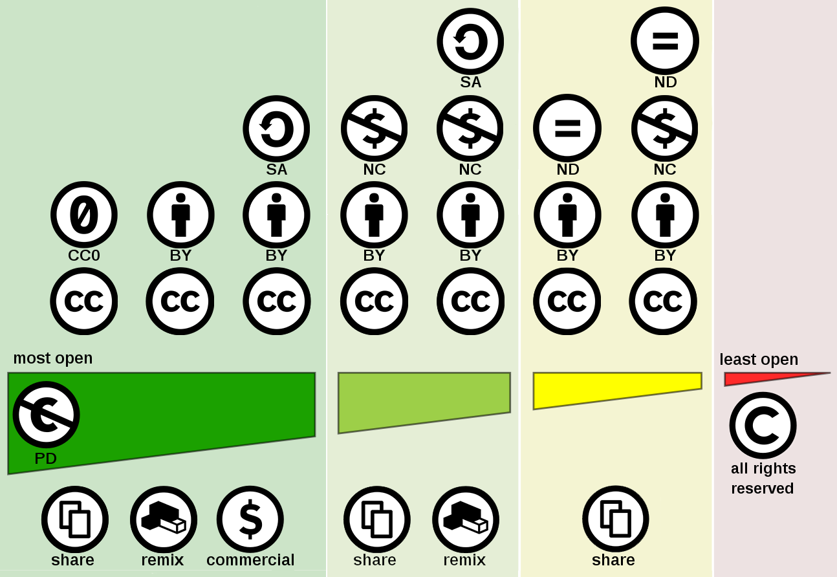
Adapted by Amanda Grey from Creative commons license spectrum by Shaddim, licensed under CC BY 4.0
Notes:
Here is a visual representation of that license spectrum, from most open on the left with the Public Domain, to the least open on the right being regular copyright.

Slide 20
Making a Resource Open
Notes:
Now that we know how licensing works, how do we make a resource open?

Slide 21
Making a Resource Open
Put a license on it
Image or Written
Provide attribution, if needed
Make it findable
Notes:
It’s fairly straightforward. There are three main steps.

Slide 22
Making a Resource Open
Put a license on it
Image or Written
Provide attribution, if needed
Make it findable
Notes:
First, somewhere on the resource, indicate which Creative Commons license you are using. You can do this by either including the license image, or by writing out the license name and linking to it.

Slide 23
Notes:
Best practice is to do both, like I’ve done for this presentation on the very first slide in the bottom left hand corner.

Slide 24
Making a Resource Open
Put a license on it
Image or Written
Provide attribution, if needed
Make it findable
Notes:
Second, make sure you’ve attributed all of the pieces that were created by someone else.

Slide 25
Notes:
Here is an example during this presentation where I provided attribution for this openly-licensed image that was created by someone else.

Slide 26
Title, Author, Source, License
5 R’s chart by David Wiley is licensed under CC BY 4.0
Author
License
Title and
Source (hyperlink)
Notes:
Attribution in open education follows a TASL format: Title, Author, Source and License. If you are using an openly licensed work, this is the information that you should to include about it in order to fulfill the attribution requirement. The order isn’t important, as long as you have all four elements. If information is missing, like there is no author information, you can leave it out of the attribution, but ideally you should aim to include as many of these elements as you can.

Slide 27
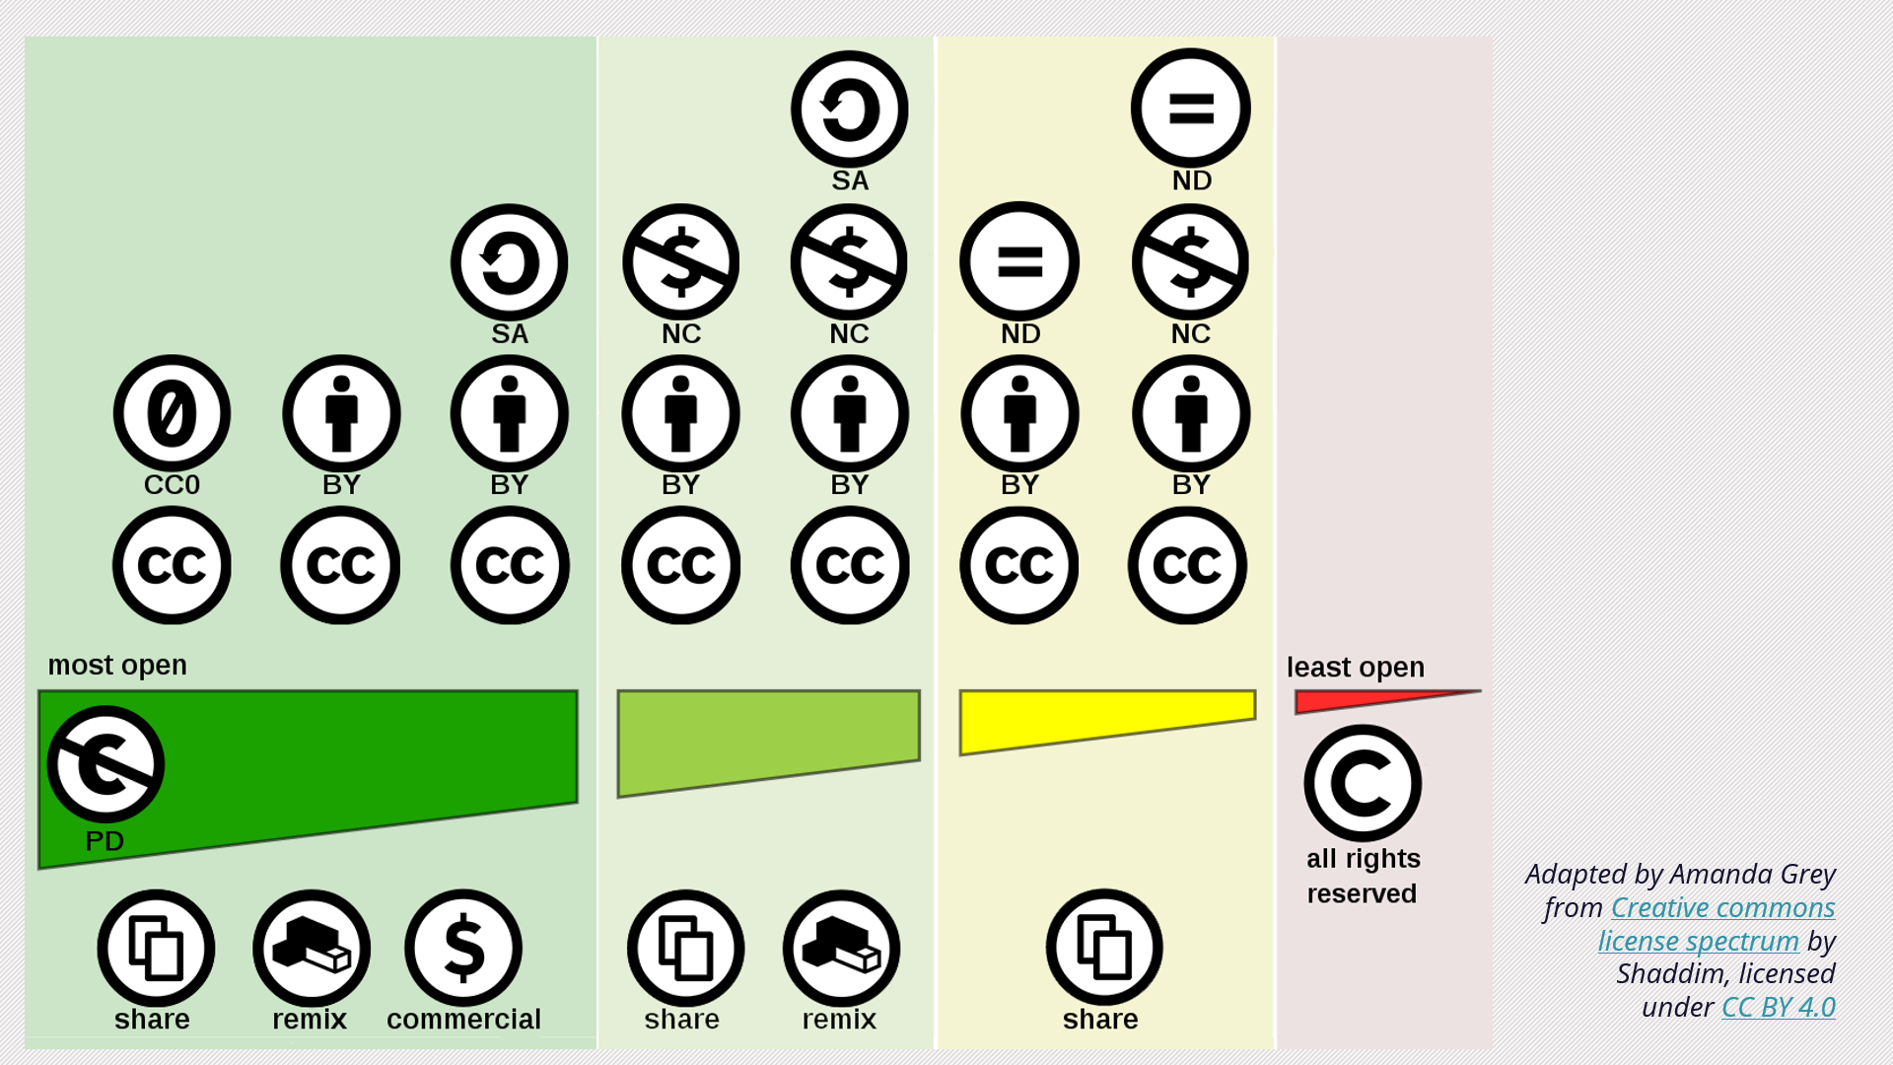
Notes:
If you’ve adapted the content, you’ll want to indicate that as well. This can be done just by saying that it was adapted before the attribution, like I did here.

Slide 28
Common Locations
Website – Footer, home page
Presentation – First slide; slide notes
Document – Footer; title/cover page
Open Textbooks – Metadata; front matter
Notes:
Here are some common places to look for and place licensing information. If you cannot find the licensing information clearly displayed anywhere, assume that it is not openly licensed and you cannot use it. This works in reverse too: if you have not placed the licensing information anywhere on your resource, it is not an OER – it’s not open.

Slide 29
Making a Resource Open
Put a license on it
Image or Written
Provide attribution, if needed
Make it findable
Notes:
Lastly, you need to publish and share the resource somewhere that that people can actually access and use it.

Slide 30
Make it Findable
OER Repositories
General (e.g. OER Commons)
Targeted (e.g. BCcampus, KORA)
Posting Share links (e.g. Google Slides)
Notes:
There are a lot of options for where you can share your resource when it’s completed. There are many online repositories that specifically focus on hosting open educational resources. There are more general repositories like OER Commons, or repositories with a more targeted focus, like the Bccampus Open Textbook collection which contains open textbooks published in BC. KPU also has our KORA repository specifically for open resources created by KPU faculty.
If a repository doesn’t quite fit your resource, you could also post a link to your project on a website, blog, or other public forum. However, this might be more difficult for people to find. One of the advantages to putting your resource in a repository is that it has a permanent home where people will always be able to access it.

Slide 31
Recap
What are OERs
Teaching resources that follow principles of open education
How OERs work
Open Licensing
Making a resource open
Apply an open license, share
KPU Teaching and Learning, CC-BY-SA
Notes:
So let’s do a brief recap of everything that I covered today:

Slide 32
Open Educational Resources
OER are teaching, learning and research materials in any medium that reside in the public domain [or] have been released under an open license that permits access, use, repurposing, reuse and redistribution by others with no or limited restrictions.
- Atkins, Brown & Hammond, 2007
Notes:
Open educational resources are teaching and learning materials that are freely available, and either in the public domain or published with an open license that enables users to engage in access, use, repurpose, reuse, and redistribution.

Slide 33
Open Licensing
Notes:
OERs work though the use of open licenses which allow others to engage in…

Slide 34
Open Educational Resources
5 R’s chart by David Wiley is licensed under CC BY 4.0
Notes:
… the 5R activities. Allowing people to legally retain, reuse, revise, remix, or redistribute a resource.

Slide 35
Making a Resource Open
Put a license on it
Image or Written
Provide attribution, if needed
Make it findable
Notes:
And lastly, to make an OER, you need to put an open license on it, make sure you’ve provided all attribution needed, and then share it with others.

Slide 36
Thank you!
Notes:
Thank you for watching!

