Slide 1
What is Open?
Open Pedagogy
Notes:
Hello! Welcome to this introductory session on open pedagogy.
This session is part of a series of presentations introducing faculty to the world of open education. We began with an overview of open education as a philosophy and set of driving principles. Our second session on open educational resources covered how to apply those principles to teaching resources. In today’s session, we are going to cover open pedagogy, which is about applying the principles of open education to various teaching practices. I am going to cover the basics of open education so you don’t need to have attended that session to understand open pedagogy.

Slide 2
In Today’s Session
What is open pedagogy
How open pedagogy works
How to engage in open pedagogy
Notes:
Today I’m going to cover what open pedagogy is, how it work, and how to engage in open pedagogical practices.

Slide 3
What is Open Pedagogy?
Notes:
I’m going to start a quick foundation of what open education is, since that is where we get the “open” in open pedagogy from.

Slide 4
What is Open Education?
“Education is a fundamental human right, globally recognized as a foundation for peace, human dignity, social inclusion, and environmental sustainability.”
- UNESCO, 2016
Notes:
Open education starts with a core philosophy that education is a fundamental human right. However, there are many different barriers that limit access to and limit engagement with education for many individuals and groups. These include physical circumstances, geographic remoteness, financial constraints, technological barriers, and/or cultural or social norms for particular individuals and groups (Brown & Czerniewicz, 2010; Lane, 2009).

Slide 5
What is Open Education?
Open education seeks to eliminate barriers to education where possible, with the aim of improving educational access, effectiveness, and equality.
Notes:
Open education seeks to eliminate as many of these barriers as possible, with the aim of improving educational access, effectiveness, and equality.

Slide 6
Principles of Open Education
Open education in practice attempts to build opportunities for learners to:
access education, resources, and scholarship
collaborate with others
create and co-create knowledge openly
integrate learning
- Cronin, 2019
Notes:
This of often done in these four ways: by building opportunities for learners to access education, teaching resources, and scholarship; by providing opportunities for collaboration; by encouraging students to create knowledge instead of passively receiving it; and integrating knowledge gained both inside and outside of the classroom.
So, the core principles of open education are access, collaboration, creation, and integration, and we can take these principles and apply them to any educational practice.
From Cronin, C. (2019). Open education: Walking a critical path. In D. Conrad, & P. Prinsloo (Eds.), Open(ing) Education: Theory and Practice. Leiden: Brill.

Slide 7
Open Pedagogy
At its core, Open Pedagogy leverages the “open” nature of Open Educational Resources (OERs) to facilitate learning and emphasizes community, collaboration, sharing resources, ideas, and power.
Notes:
When we apply those open principles to teaching practices, we get open pedagogy.
There are a lot of different definitions of Open Pedagogy floating around, and depending on your personal teaching beliefs and style, and it will look slightly different when you apply them to different teaching practices…

Slide 8
Open Pedagogy
Engaging in open pedagogy practices centres
agency, consent, care, compassion
opportunities for JEDI;
embraces students creating content; and
provides scaffolding for tools and assignments.
Notes:
… but at it’s core, engaging in open pedagogy practices centres learner agency and consent; centres care and compassion; offers opportunities for justice, equity, diversity, and inclusion (JEDI); embraces students creating content; and provides scaffolding for tools and assignments.

Slide 9
How Open Pedagogy Works
Notes:
Let’s get into what this actually looks like in practice.

Slide 10
Characteristics of Open Pedagogy
The characteristics of open pedagogy are:
Incorporating feedback
Providing options
Encouraging ownership
Having value beyond knowledge
Sharing with others
Notes:
If your teaching practice are
Incorporating feedback
Providing options
Encouraging ownership
Having value beyond knowledge
Sharing with others
Then you are engaging in open pedagogy. These characteristics can be applied to any teaching practice, to varying amounts. You might find that some characteristics aren’t appropriate for a particular teaching practice but are great for others.

Slide 11
Characteristics of Open Pedagogy
Examples of Open Pedagogy
Building OERs with students
Students co-create pieces of the course
Asking students for feedback about assignment instructions
Notes:
Here are a few examples of open pedagogy practices.
Incorporating student work into the creation of an open educational resource
Having students co-create the course structure and content by giving students choices during their assignments, having students create the rubric for their assignments, or asking your class to create the syllabus together.
Lastly, even just asking students for feedback about their assignments to find out whether there were any barriers they faced and using that information to re-design the assignment for next time.

Slide 12
Characteristics of Open Pedagogy
The characteristics of open pedagogy are:
Incorporating feedback
Providing options
Encouraging ownership
Having value beyond knowledge
Sharing with others
Notes:
Open pedagogy is a spectrum – the more of these characteristics you are employing in your class, the more you are engaging in open pedagogy.

Slide 13
Engaging in Open Pedagogy
Notes:
Now that we have an idea of what we are looking for with open pedagogy, we can start looking closer at how to apply them to teaching practices. Today I’m going to specifically cover how to apply open pedagogy principles to assignment design, since that is the most common area that open pedagogy shows up and is a good way to get started.

Slide 14
Engaging in Open Pedagogy
Renewable Assignments
vs
Disposable Assignments
Notes:
A common teaching practice to apply open pedagogy to is assignment design, and there are lots of examples of these assignments
When an assignment has characteristics of open pedagogy, it’s called a “Renewable Assignment”, as opposed to traditional, disposable assignments that are transactional in nature – a student does the work, hands it in, it gets marked, and then it goes in a drawer and no one ever looks at it again.
So let’s break down how to apply open pedagogy principles to assignment design as an example for how to incorporate open pedagogy into a teaching practice.

Slide 15
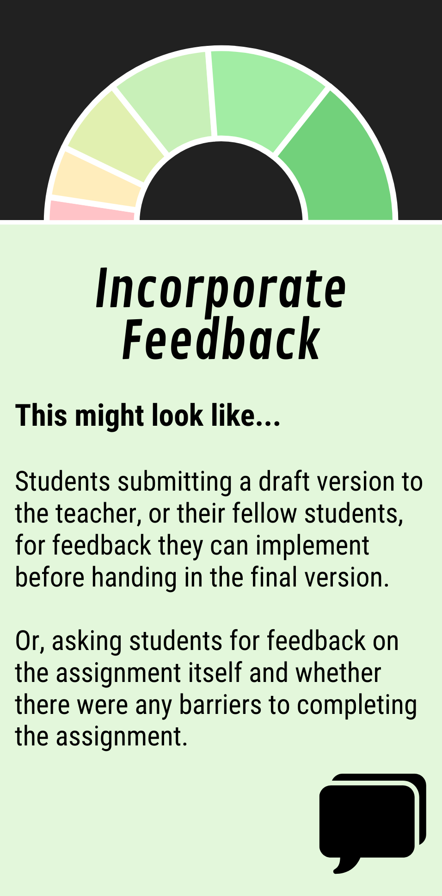
Incorporate Feedback
Peer to peer
Teacher to student
Student to teacher
Notes:
The first characteristic of Open Pedagogy is Incorporating Feedback.
When it comes to assignments, there’s a few ways this could go. You could have their fellow students give feedback during peer review, you could ask students to hand in a rough draft that you give feedback on (ungraded), that students can implement before handing in the final version, or you could go broader and ask students to provide YOU with feedback on the assignment and whether they had any difficulties. You could get useful feedback about whether the instructions were unclear, if a tool was difficult to use, or other issues that students may face during an assignment.

Slide 16
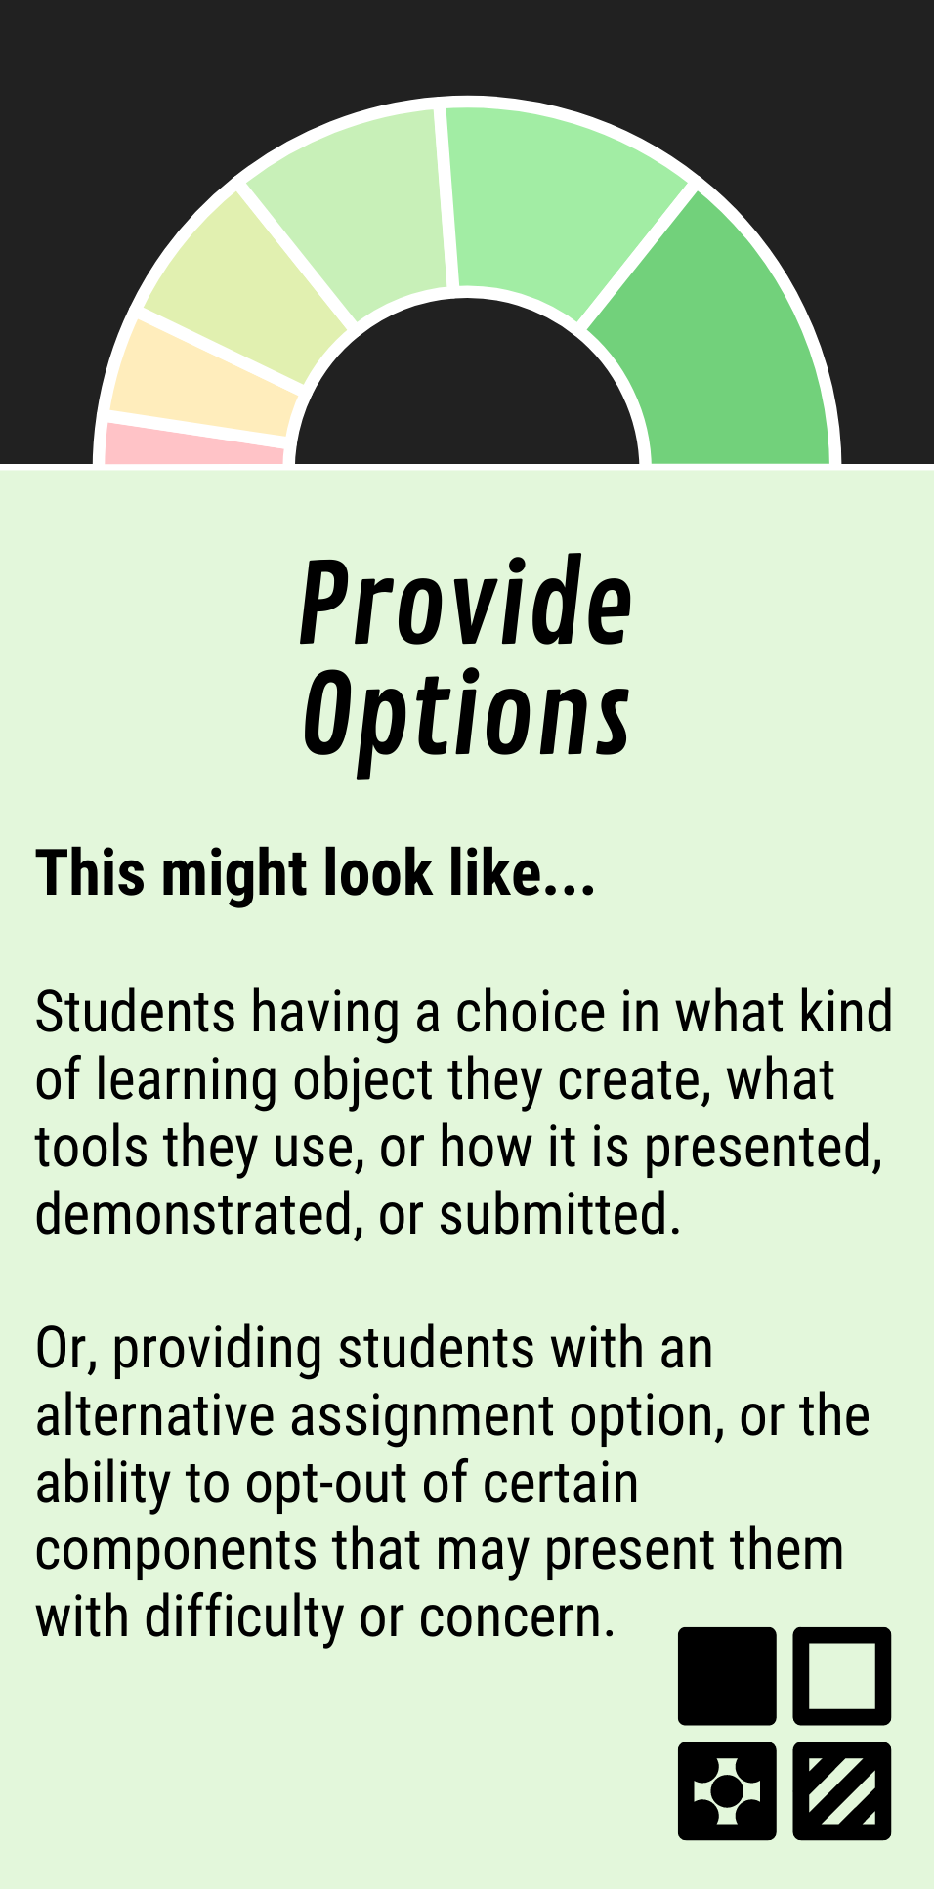
Provide Options
What they create
Tools they use
How they demonstrate
Notes:
How can we Provide Options for assignments
Well, you can give students a choice in what learning object they create – for example they could choose to write an essay, or write a podcast episode. They could choose what tools they use and how they demonstrate their learning – for example, they could choose a traditional presentation at the front of the room, or maybe they could create a video essay.
Students may still choose to submit a traditional assignment because it is comfortable and familiar, but the choice can be very meaningful for students who express themselves in different ways or have different skills they can draw on.

Slide 17
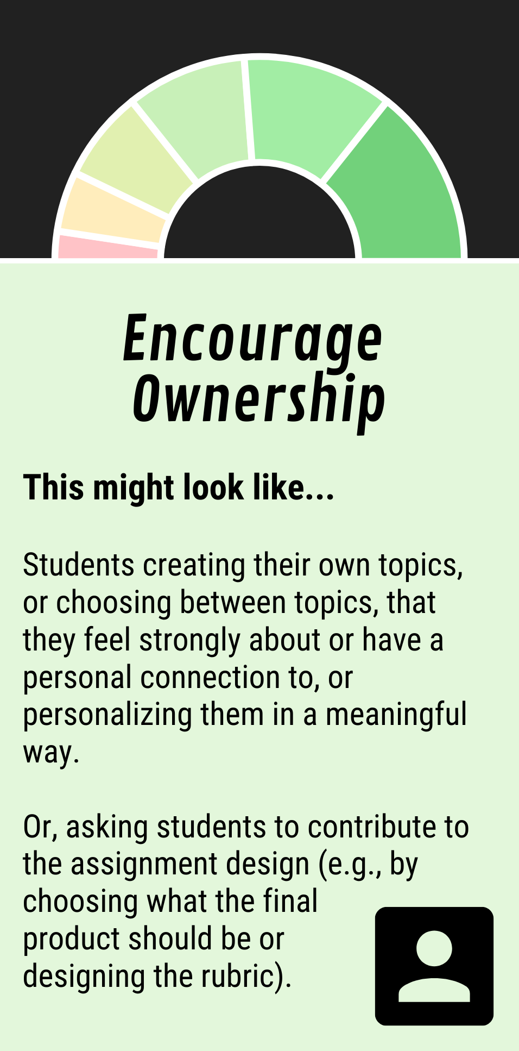
Encourage Ownership
Create their own topics
Personalize a topic
Co-create rubric
Notes:
Next up let’s do the Open Pedagogy Principle of Encouraging Ownership.
For assignments, there’s a few different ways that ask students to take more ownership. You could ask students to choose or create their own topics, or provide the opportunity to personalize a topic in a meaningful way. You could also co-create the assessment rubric together as a class, so students are also identifying the value of an assignment and what is important to succeed.

Slide 18
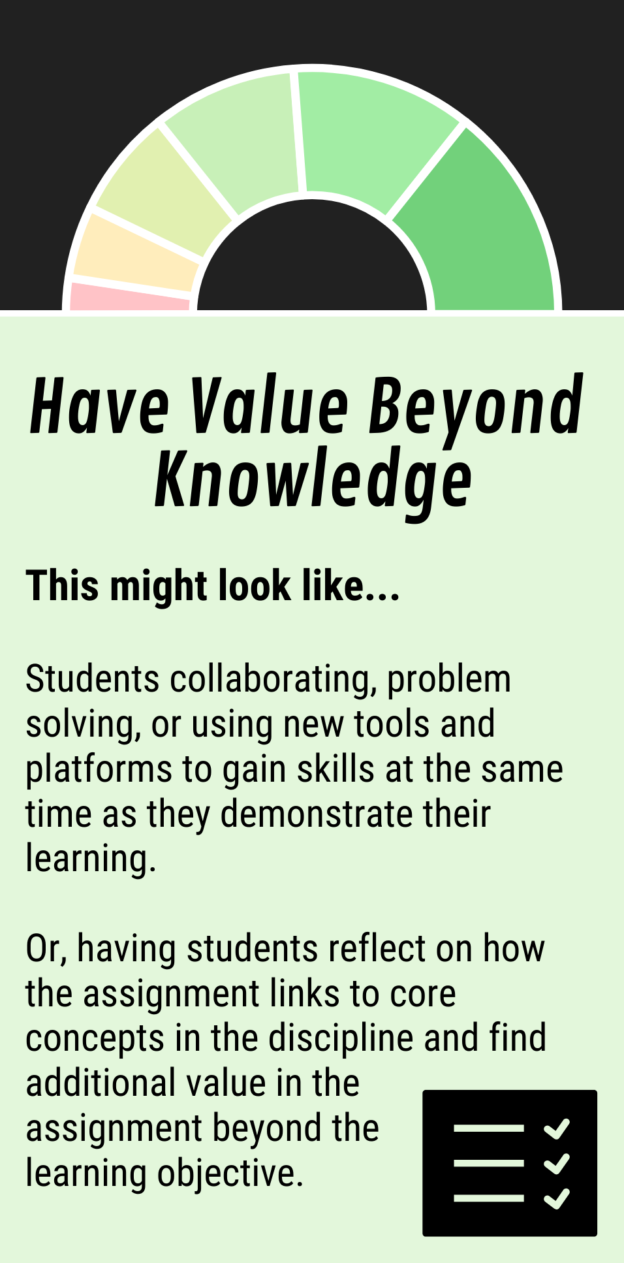
Value Beyond Knowledge
Development of other skills
New tools and platforms
Reflect on relation to concepts
Notes:
Open Pedagogy means that there is value beyond knowledge.
The primary characteristic of a disposable assignment is that once the grade is earned the assignment has no more value, so to add value you could incorporate the development of collaboration and problem-solving skills into an assignment. This could also be done by having students learn to use new tools and platforms so they are gaining new competencies at the same time as they are demonstrating their learning.
You could also ask students to reflect on how a particular assignment links to other core concepts in the discipline, or how the knowledge they have gained scaffolds into what they will learn in the rest of their program and careers.

Slide 19
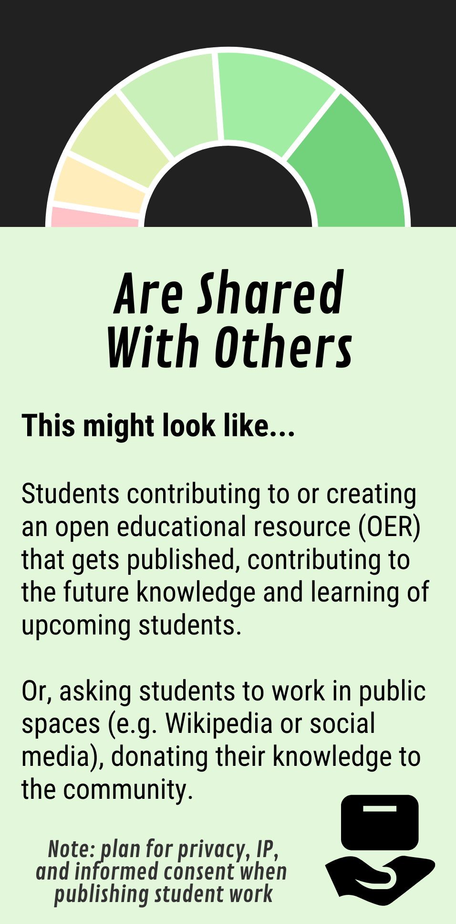
Shared With Others
Create an OER
Develop guides/walkthroughs
Work in public spaces
Notes:
The last principle of open pedagogy is that resources are shared with others.
This might be the most straightforward of all of the principles, since using student work to contribute to an Open Educational Resource (OER) is one of the most common ways to do open pedagogy and renewable assignments. For those that are unaware, OERs are freely available teaching materials that are openly licensed so that other people can use, adapt, and share them.
However, you could also have your students develop guides and walkthroughs for future students to learn from. Or, another common renewable assignment is to have students work in public spaces such as Wikipedia or on social media platforms where they are sharing their knowledge with the community instead of just with their instructor.
I do want to flag, that when you are asking students to publish and share their work outside of the closed classroom, you need to pay special attention so that students’ privacy and intellectual property are protected. Students need to give informed consent to having their work published and alternative options must be provided for students who decline.

Slide 20
Notes:
A Renewable Assignment could do just one of these things to be considered open pedagogy, and the more of these that you do, the higher on the spectrum it is.

Slide 21
Characteristics of Open Pedagogy
The characteristics of open pedagogy are:
Incorporating feedback
Providing options
Encouraging ownership
Having value beyond knowledge
Sharing with others
Notes:
By engaging in Open Pedagogy, we are inviting students to engage more meaningfully and creating space for students to insert more of themselves into their learning. This has always been possible for keen and interested students, but explicitly designing pathways and presenting alternatives has the potential to draw in students who wouldn’t otherwise have taken the initiative or feel uncomfortable going outside of the implicit boundaries of traditional assignments

Slide 22
Recap
What is open pedagogy
Teaching practices that follow principles of open education
How open pedagogy works
Characteristics of open pedagogy
Engaging in open pedagogy
Renewable assignments
Notes:
So let’s do a brief recap of everything that I covered today:

Slide 23
Open Pedagogy
Engaging in open pedagogy practices centres
agency, consent, care, compassion
opportunities for JEDI;
embraces students creating content; and
provides scaffolding for tools and assignments.
Notes:
Engaging in open pedagogy practices centres learner agency and consent; centres care and compassion; offers opportunities for justice, equity, diversity, and inclusion (JEDI); embraces students creating content; and provides scaffolding for tools and assignments.

Slide 24
Characteristics of Open Pedagogy
The characteristics of open pedagogy are:
Incorporating feedback
Providing options
Encouraging ownership
Having value beyond knowledge
Sharing with others
Notes:
Open pedagogy practices
Incorporate feedback
Provide options
Encourage ownership
Have value beyond knowledge
Share with others

Slide 25
Notes:
An easy way to engage in open pedagogy is to incorporate renewable assignments into your course, where assignments live on after they are completed and are not disposable.

Slide 26
Thank you!
Notes:
Thank you for watching!

