Slide 1
Title
Notes:
Add a logo to the corner of your slides for consistent style/branding. A small image on every slide gives visual confirmation the PowerPoint overlay is working.

Slide 2
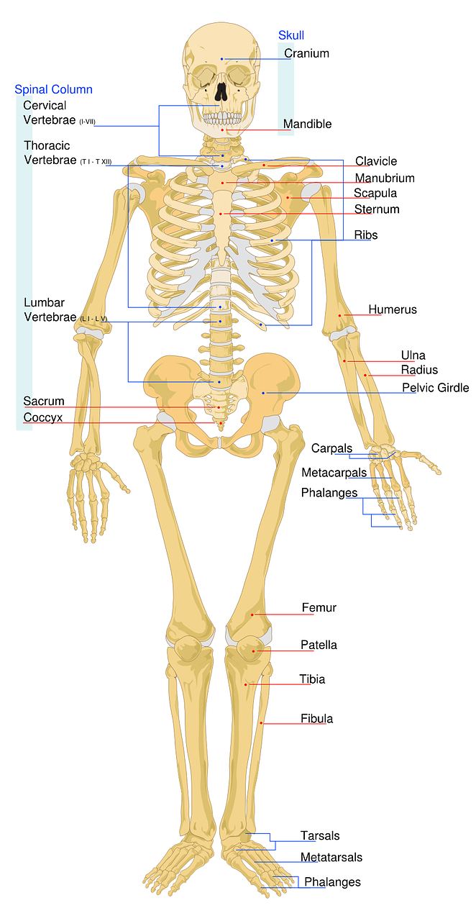
Notes:
This skeleton can be annotated using a lightboard for a very engaging illustration.
Before recording, overlay image and use confidence monitor to place dots on the glass for each item. These reference points will make it easier to apply labels when filming without as much reliance on the confidence monitor for accurate location. Presentation value is enhanced when the presenter is able to look at the glass as if the image is really there.
Image sources:
https://pixabay.com/en/human-skeleton-anatomy-bones-1813086/
https://pixabay.com/en/skeletal-labeled-worksheet-skeleton-40500/

Slide 3
Notes:
Blank slides are powerful. They build a pause into your presentation to interact directly with your audience. If presenting live, this can be a reminder to stop and engage the audience, ask questions and discuss.
Add a logo to the corner of your slides for consistent style/branding. A small image on every slide gives visual confirmation the PowerPoint overlay is working.

Slide 4
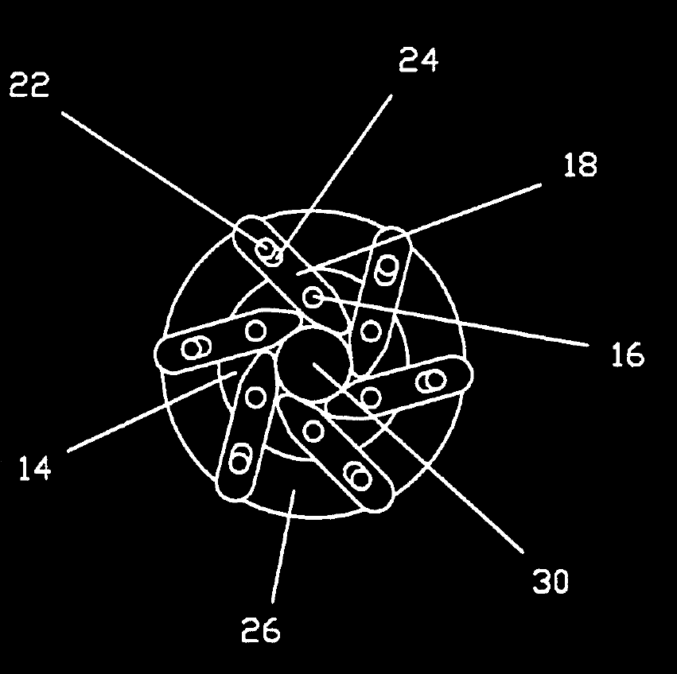
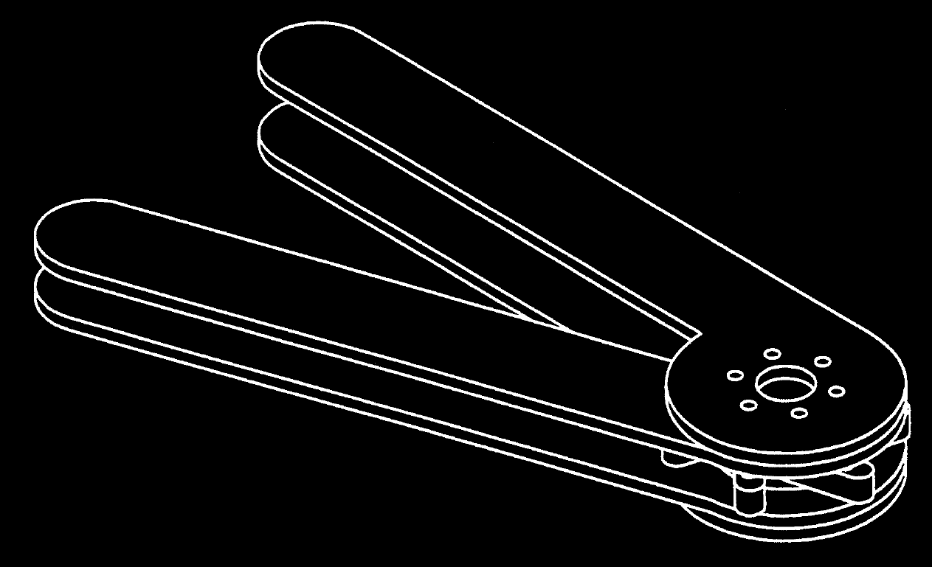
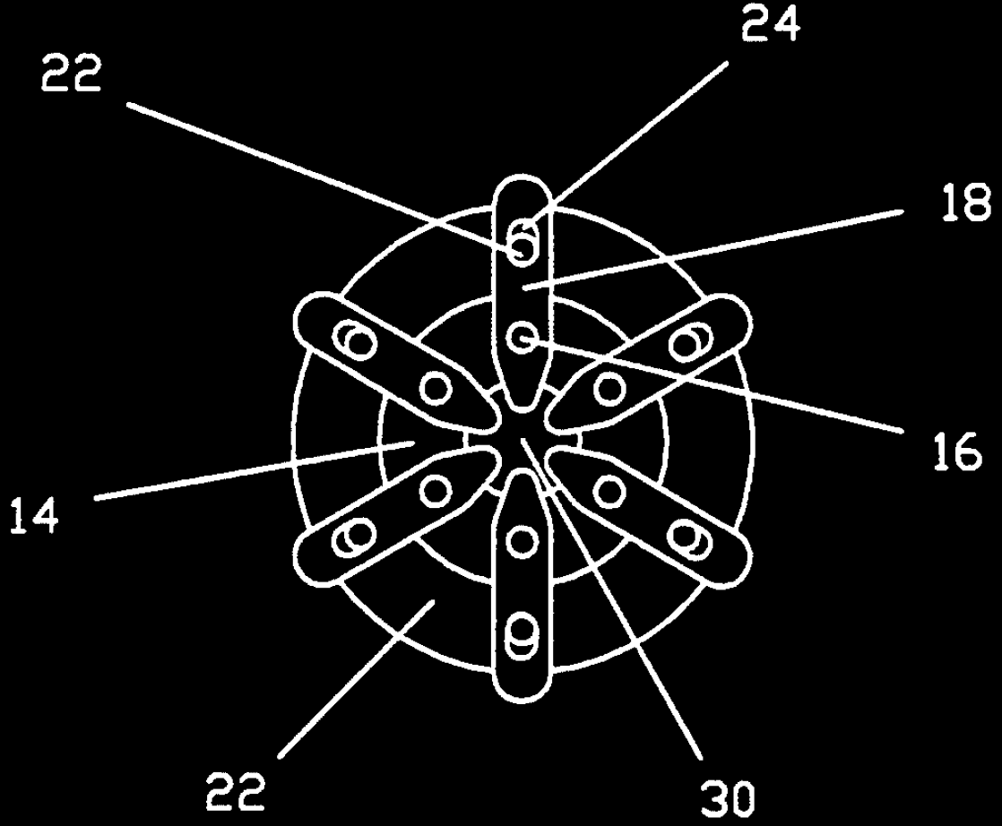
Notes:
Here is an example of a fixed diagram. These images were retrieved from the USPTO patent database, black-white inverted and cleaned of nuisance marks.
Image Source: US Patent 5261263

Slide 5
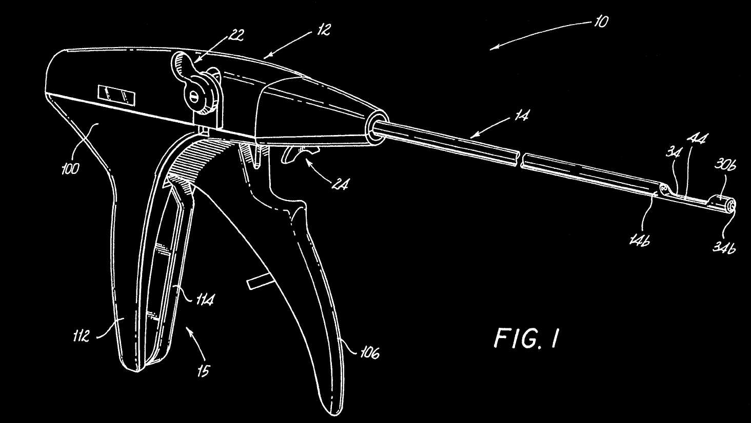
Notes:
White line images provide good subjects for annotation and explanation of a complex component or system with clear context while retaining a lightweight feel.
Image source: US Patent 5431666

Slide 6
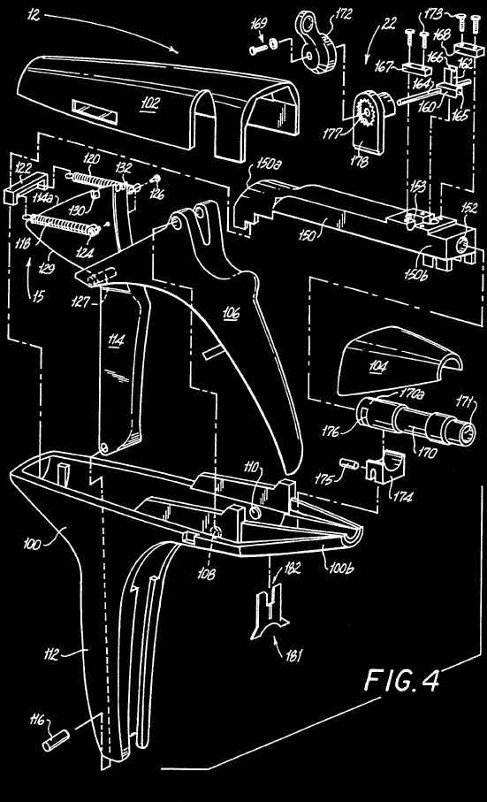
Notes:
White line exploded part diagrams can give greater detail with high fidelity. Individual component interactions from this example would be great to draw by hand to illustrate.
Image Sources: US Patent 5431666

Slide 7
For Loop
Output:
0
1 2 3 . . . 99
Initialize Statement
Update Statement
// Print numbers 0 to 99 (not 100)
//each separated by a space.
for (int i=0; i<100; i++)
{
System.out.print(i);
System.out.print(' ');
}
.
.
.
Test Expression
True
Body of For Loop
False
Exit For Loop
Notes:
Slide animations can enhance presentations in some cases.
Play this slide in presentation mode to see the red boxes appear and disappear to illustrate corresponding functional and code representations in sequence.
In this example the outputs shown in green would be best deleted from the slides and written in by the presenter one at a time to illustrate loop iterations.

Slide 8
CH₄(g) + 2O₂(g) → CO₂(g) + 2H₂O(g)
CH₄ + 2O₂
Potential Energy
CO₂ + 2H₂O
reaction progress
The difference in PE is transformed into kinetic energy and light energy
(Law of Conservation of Energy).
Notes:
Want to create animations in your presentations? PowerPoint has many possibilities for the creative mind!
Writing out the chemical reaction at the top would add engagement and help viewers focus on what is being presented. The text box in the lower right could also be replaced by a marker written explanation to improve focus on that takeaway. Change text color to black to make invisible during presentation but retain the information for reference.
Special thanks to Joel Weiner at Evanston Township High School who created this slide. Check out Joels chemistry videos on his Youtube channel: Crash Chemistry Academy
https://www.youtube.com/channel/UCqL65NPW4ajAT5ahA3RkNJQ

Slide 9
Let your personality shine!
Notes:
Have fun and let your unique personality shine!
If you have an idea and want help figuring out how to make it happen, please contact us.

